Slide 1
Introduction to R
Ramsy Agha
Feb 2020
Disease Eco-Evo Lab

Slide 2
Content (what we are going to do)
Day
Thu 6.2.20 | 9h | Intro to R and RStudio
 | 10.30h | Data import and quality check
 |  | Lunch break
 | 13h | Data manipulation (
 |  | Visualization with ggplot2
 |  | ggplot2 challenge
Fri 14.2.20 |  | Statistical analyses using R
 |  | Open lab (work with your data)
Intro on R and RStudio
data handling:
data collection and quality check
manipulation and summary statistics
Visualization using ggplot2
interpretation and presentation

Slide 3
Good Practice during this tutorial
PowerPoint interspersed with Challenges
Ask lots of questions!
Work together
Take breaks
Cheat!

Slide 4
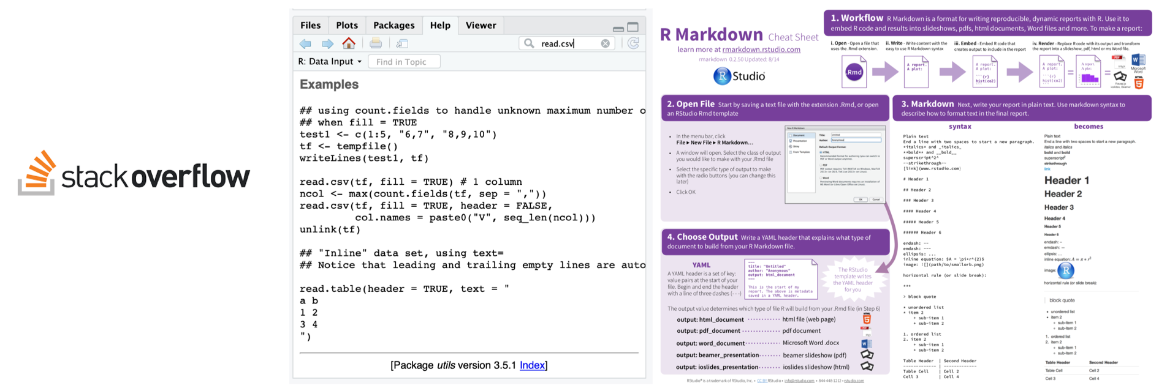
Cheating is allowed
Stackoverflow
?function() (takes you to documentation pages)
cheatsheets (see folder in the course repository!)

Slide 5
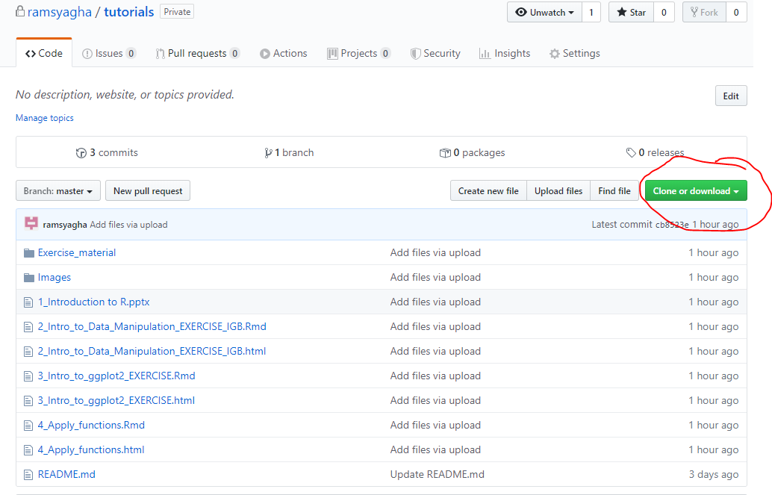
All materials are available
https://github.com/ramsyagha/tutorials
Remember the path where you download the zip file:
This will be your working directory!
If havent already,
Pls do this now!

Slide 6

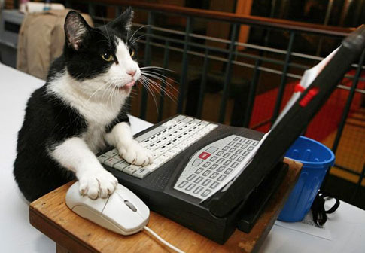
Watching vs Doing
Listen when you see this cat
Do when you see this cat

Slide 7
R and RStudio
- R: free software environment for statistical computing and graphics
- RStudio: integrated development environment (IDE) for R

Slide 8
Why R?
powerful, flexible/customizable
easy for sharing and developing
reproducible science: scripts and markdowns

Slide 9
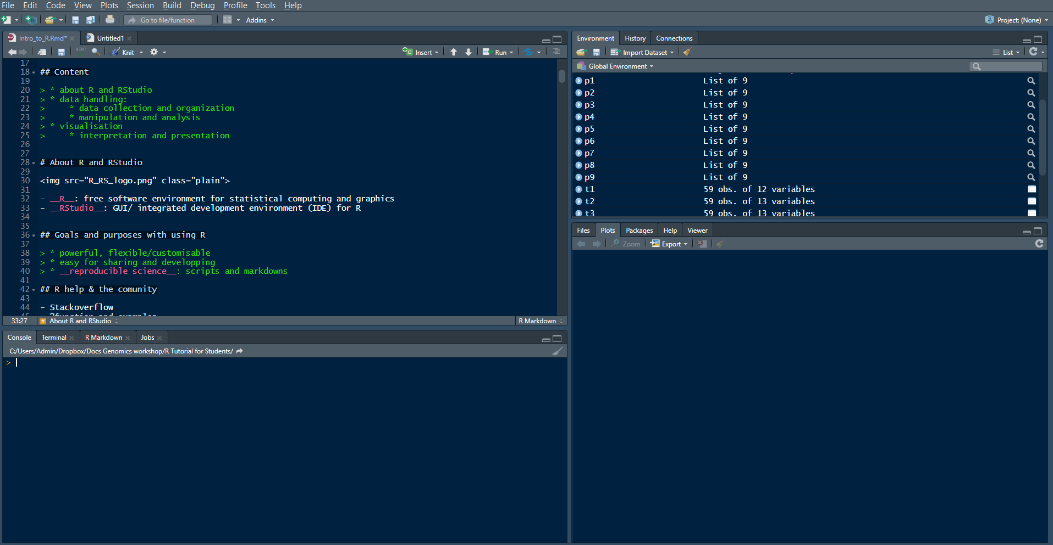
What is RStudio
SOURCE (Your notepad for code)
This is where you write your code
Your code will not be evaluated until you run it
(use „run“ button or Ctrl+Enter to run individual lines of code
3. ENVIRONMENT / HISTORY
Here you can see what objects are loaded into your working space and see your command history
4. FILES/PLOTS/PACKAGES/HELP
Here you can see file, directories, packages and help documentation (R help).
2. CONSOLE (R´s heart)
This is where your code from the source will be evaluated by R
You can also perform quick calculations that you dont need to save

Slide 10

Try it now
Type in your console:
12+13+14
(5+2)*2
12^2
These are Arithmetic operators (basic math): +, -, *, /, ^, …

Slide 11
Try it now
Assignment:
Type the following in your console
x <- 12
y <- 13
z <- 14
Look at your environment pane. What happened? Now type in your console:
x+y+z
This is an assignment operator <- You define R-objects with it

Slide 12
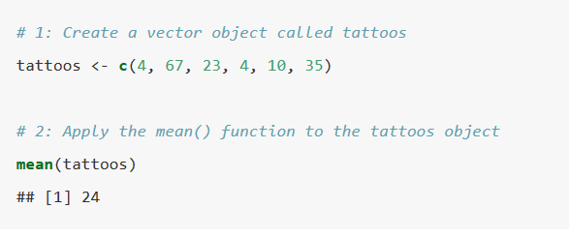
Objects and functions
R revolves around 2 things: Objects and Functions
I will define an object called tattoos using the function c() and then compute it mean using the function mean()

Slide 13
Functions
function (object, arguments)
You can always type ?function() is your console to get information about what the function does and which aeguments it accepts
Try typing in your console:
?str()

Slide 14

Try it now
Create a vector object called k consisting of the numbers 12, 13 and 14.
Compute the sum of the vector k using the function sum()

Slide 15
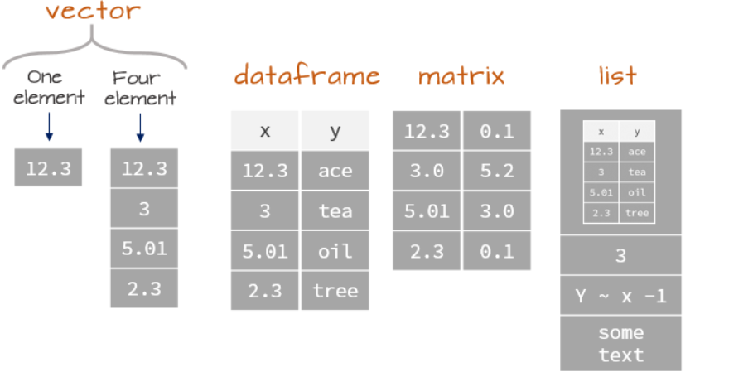
Data structures in R: Object types
What type of object did you just create?

Slide 16

Inspecting objects
Lets create another vector called animals on top of the vector k we created earlier
Lets inspect them. What do you see?
What are we doing with this?
(Remember str() you will use it a lot!)

Slide 17


Modifying vectors
Lets modify those vectors. Try this code and think about R is doing
Remember the [] can be used to refer to elements of an object. The referal can be coordinate (e.g. first element k[1], or logical operations k[k<4]).
Try this now. Can you figure out what´s going on?

Slide 18

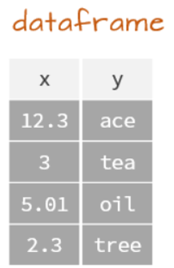

Data frames
Lets create some more compex objects
Inspect it
Modify it

Slide 19
Data frames
Selecting data within a data frame is similar as we saw with vectors. We use [] as well, but now w have 2 coordinates.
Use dataframe[row, column]
(omission of any of the coordinates means select all)

Slide 20
Data frames
Challenge: What do these commands do?

Slide 21
If You’re Typing too much, You’re Doing Something Wrong!
Tab complete is a nice trick to save you typing, functions, dataset names, variables etc. that have been defined in the R environment will be autocompleted.

Slide 22
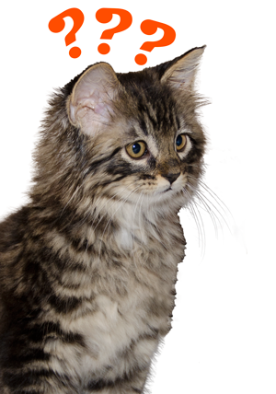
Questions?

Slide 23
Data collecting quality check

Slide 24
Data handling: collecting and organisation
Conventions about data format
Observations are entered in rows
Variables are entered in columns
A column of data should contain only one data type

Slide 25
Data handling: collecting and organisation
Best practice
Store a copy of data in nonproprietary formats
Leave an uncorrected file when doing analyses
Create folders for relevant task to keep the overview over your analyses

Slide 26
Error messages
Warnings should be acknowledged but can be ignored.
Specific hint? e.g.
wrong data format, characters/factors instead of numbers
library not loaded, package not installed
Try running example code, and check the example input
Google is your friend – cheating is allowed

Slide 27
Your task before we get started!
Make sure that:
Rstudio is installed properly in your computer
The following packages have been installed:
tidyverse
dplyr
use install.packages() function to install them

